Slide 1
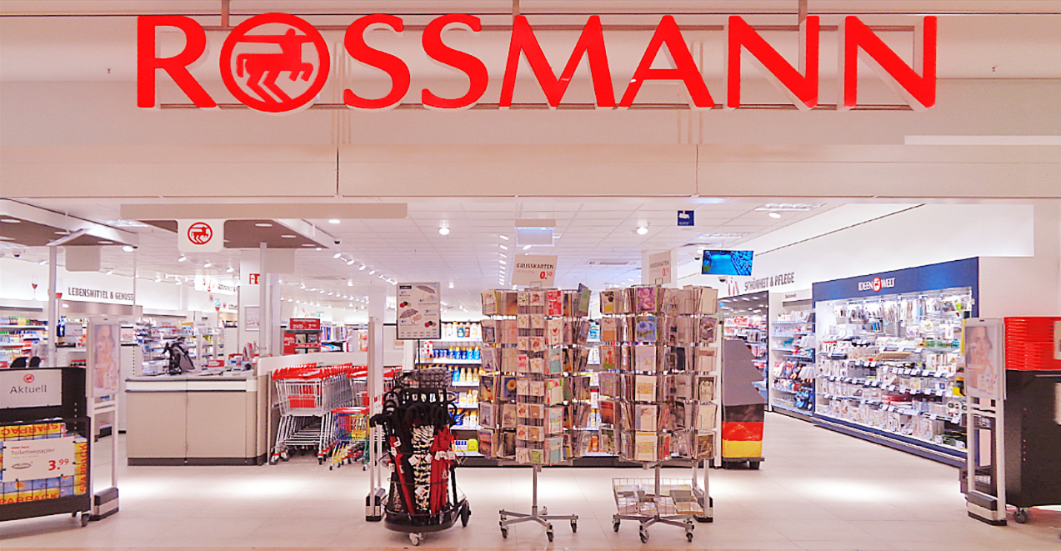
Sales Forecasting Solution for Rossmann Pharmaceuticals

Slide 2
Introduction to the Rossmann Pharmaceuticals
Rossmann Pharmaceuticals: A Leading Name in Pharmaceutical Retail
Established Reputation: Trusted for Quality Healthcare Solutions
Nationwide Presence: Operating Across Multiple Cities and Regions
Commitment to Excellence: Providing Accessible Healthcare Products and Services
Strategic Focus: Embracing Innovation to Enhance Customer Experience and Operational Efficiency
Introduction to Sales Forecasting Project: Addressing Challenges and Opportunities for Growth

Slide 3
Project overview
Project Name: Sales Forecasting Enhancement for Rossmann Pharmaceuticals
Objective: Develop and implement an advanced sales forecasting system.
Key Features: Leveraging machine learning techniques, incorporating factors such as promotions, competition, holidays, seasonality, and locality.
Goal: Accurately predict sales across all stores, six weeks in advance, to support informed decision-making by the finance team.

Slide 4
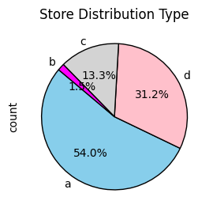
Understanding Store Type Distribution in the Pharmaceutical Business
Market Dominance: Store Type A holds majority share.
Niche Focus: Store Type B targets specialized market segments.
Market Diversity: Presence of multiple store types caters to varied customer preferences.
Growth Opportunities: Store Type D presents potential for investment and expansion.
Optimization: Performance analysis per store type aids in resource allocation and profitability.
Conclusion
Understanding store type distribution aids in strategic decision-making, ensuring market dominance, capitalizing on growth prospects, and optimizing operations within the pharmaceutical business.

Slide 5
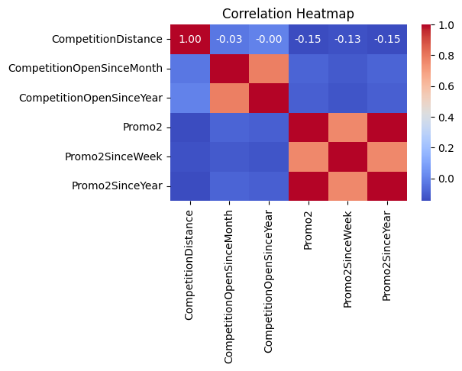
Correlation Analysis of Pharmaceutical Store Dataset

Slide 6
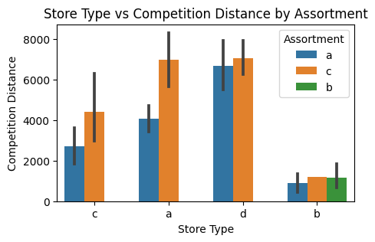

Slide 7
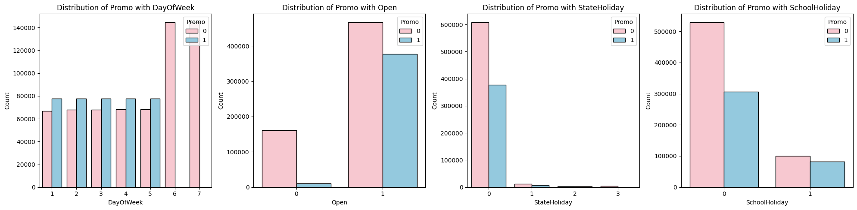

Slide 8
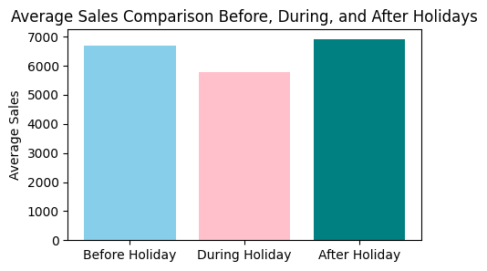

Slide 9
